Slide 1

Group 8
DATA7001 Introduction to Data Science
Group Project
Notes:
Duration: 0:15.
Speaker: CJRS.
Welcome to our presentation for DATA7001. We are group 8.

Slide 2
Group 8
Siamak Adeli Koodehi
Cristhyan Cardona Garcia
Matthew Colwell
Christopher Symons
Hai Hung Vu
Notes:
Duration: 0:15.
Speaker: CJRS.
(I think we just quickly say first names and move on.)

Slide 3
The Problem (Solving with Data)
Sports rorts - the National Audit Office found that Government spending grants were influenced by the applicant’s electorate locations [SMH link]
Human centered design: we imagined a concerned taxpayer and engaged voter; how can that person work out whether government is spending fairly? Porkbarreling?
Large volume of spending data: dozens of projects, billions of dollars, 93 electorates (Queensland state gov’t alone.)
How can that our taxpayer map the spending to keep an eye on pollies?
Notes:
Duration: 0:45.
Speaker: CJRS.
(Probably already too much content. May split in to two.)

Slide 4
[ live demo ( / storytelling with data ) ]
1
2
3
Notes:
Planned duration for this item: 2:30.
(Screen recording of demo of web tool by SAK and CCG with commentary.)

Slide 5
Getting the Data (I need)
Electoral boundaries: shape file (set of 93 named polygons in lat long coordinate system) available from Qspatial [link].
Spending data: some success reading pdf tables from State Infrastructure Plan [link] but challenging to get clean data; located alternative csv data at Qld Gov’t Open Data Portal [link].
Election results (input by MBC).
Other/Census (input by all).
Notes:
Duration: 1:00.
Speaker: CCG.

Slide 6
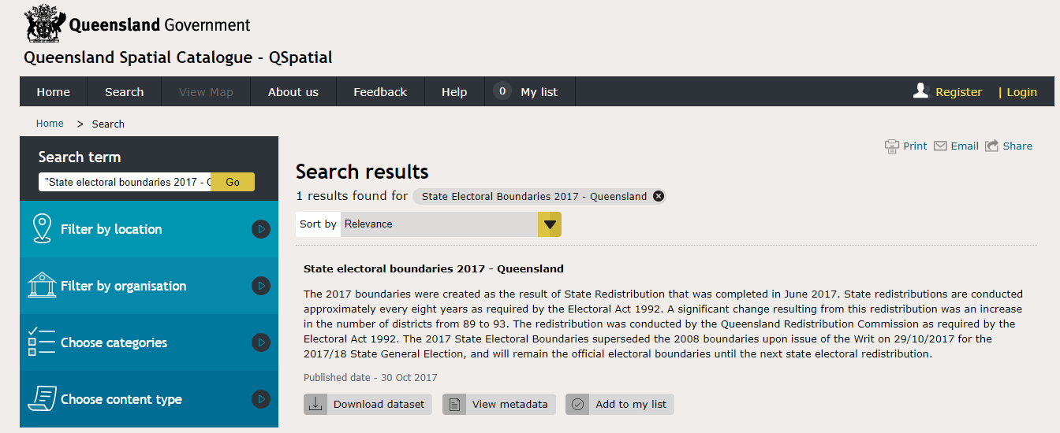
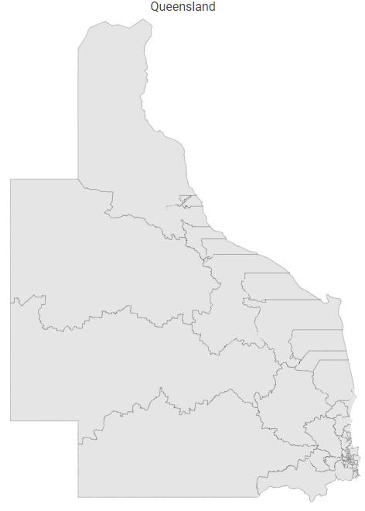
Getting the Data (I need)
Electoral boundaries (shapefile Map)
Notes:
Planned duration for this slide: 1:00.

Slide 7
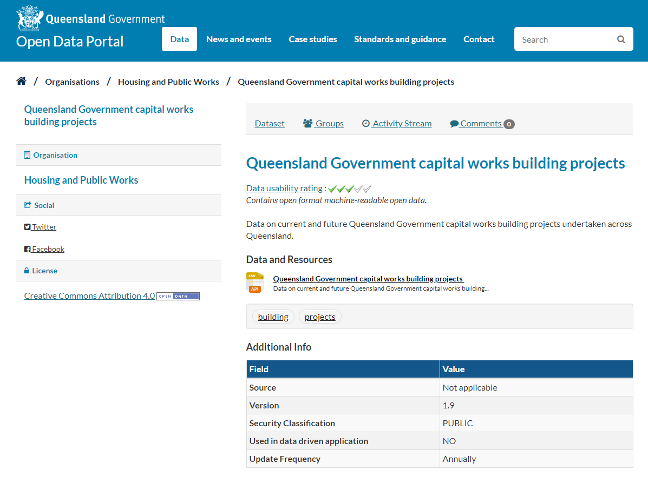
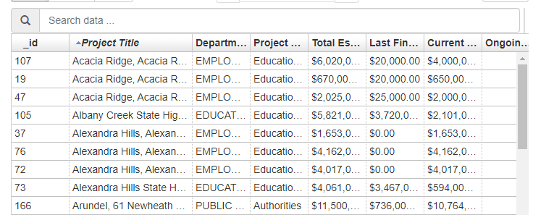
Getting the Data (I need)
Infrastructure projects (CSV)

Slide 8
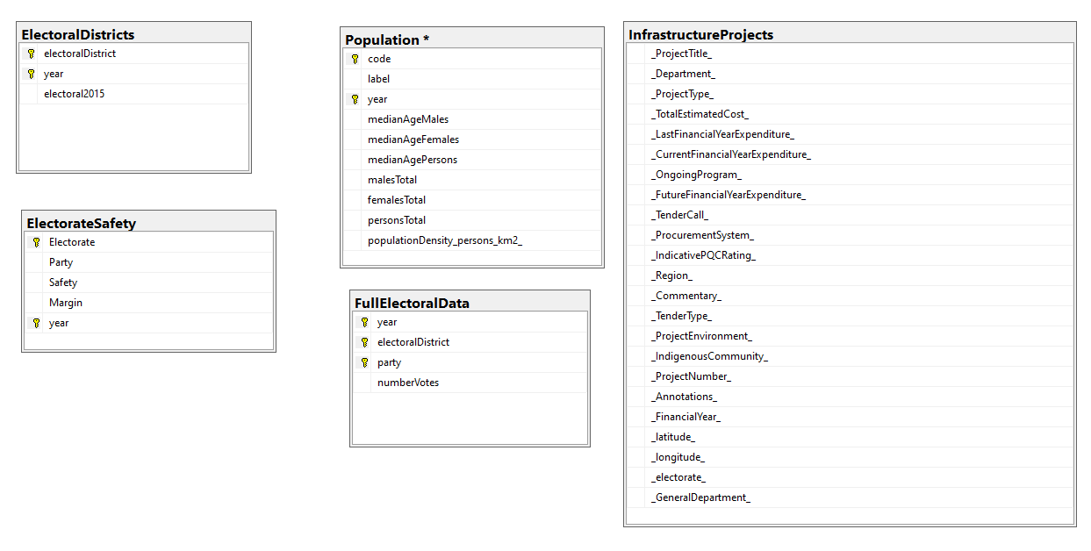
Getting the Data (I need)
Database

Slide 9
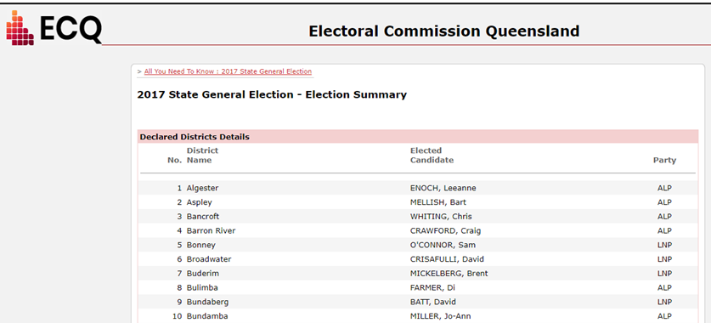
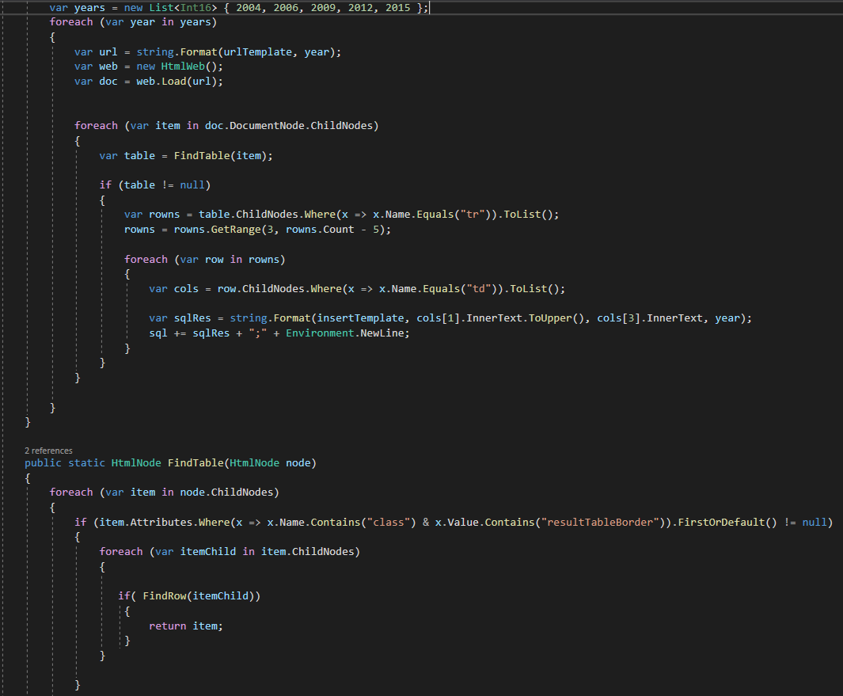
Getting the Data (I need)
Electoral Data (Web Scraping)

Slide 10
Is my data fit for use?
Data quality, cleaning, integration.
Collabroation: GitHub.
how we developed a cloud-based DataBase.
Data Enrichment.
Census data (input by HHV).
Notes:
Duration: 0:30.
Speaker: SAK & MBC

Slide 11
Making the data confess
Methodology (transform variables -> correlations -> plot and develop models)
Follow with visuals: correlation matrix, logistic regression, Linear Spending vs Labour Margin (not overt), Unexpected relationships
Notes:
Duration: 1:00.
Speaker: MBC. ?HHV too

Slide 12
Conclusion
What we did (data science process).
What we found (very briefly).
What we could do next: more advanced statistical techniques, more and better data, temporal data, more sophisticated method of classifying seat safeness.
Notes:
Duration: 0:30.
Speaker: HHV.

Slide 13
Thank you / any questions
1
2
3
Notes:
Duration: 0:15.
Speaker: HHV.

